Slide 1
LSI Design Contest 2018
Neural Network (Backpropagation)
Huy-Hung Ho, Van-Thuat Nguyen,
Xuan-Thuan Nguyen, Van-Dung Nguyen
Key Laboratory for Smart Integrated Systems (SISLAB)

Slide 2
Outline
Introduction
Backpropagation algorithm
Hardware implementation papers
Plan future

Slide 3
Introduction
Challenge: "Neural Network(Backpropagation)“
Deadline: 31st Jan, 2018

Slide 4
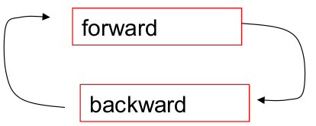
Propagation Algorithm
Feed forward propagation
  Single perceptron
  Activation function
Backward propagation

Slide 5
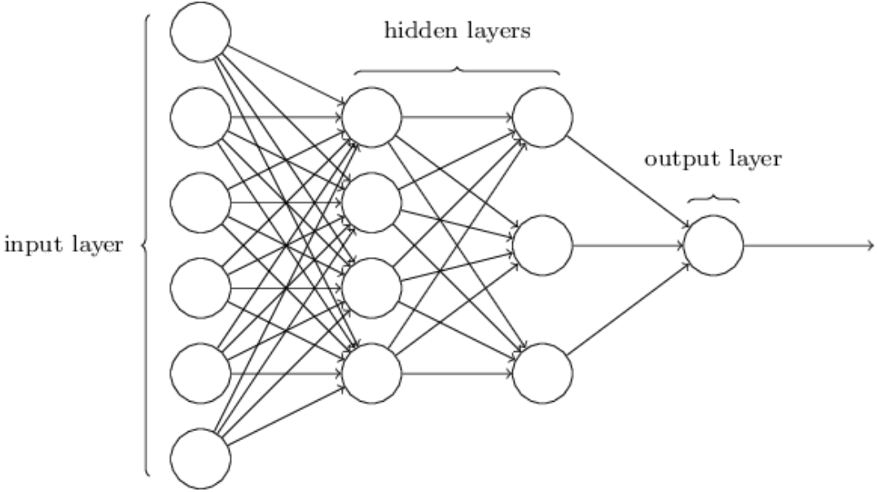
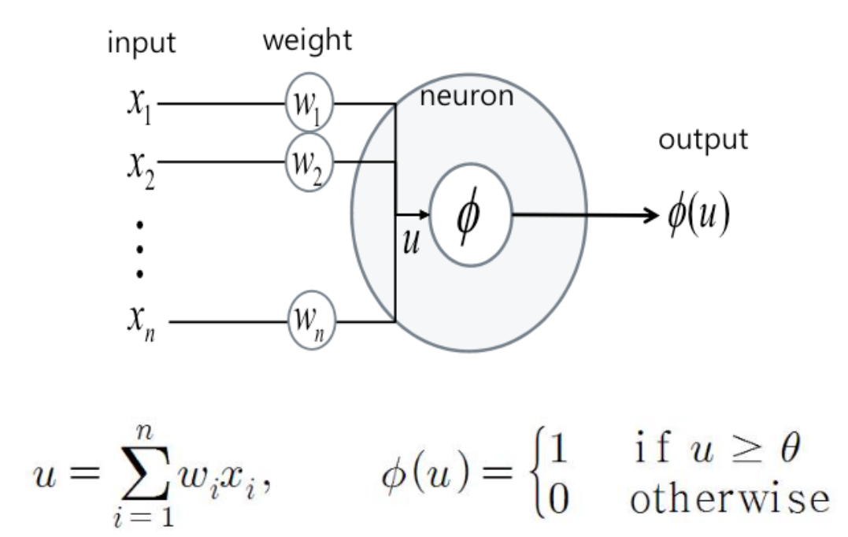
Single perceptron

Slide 6
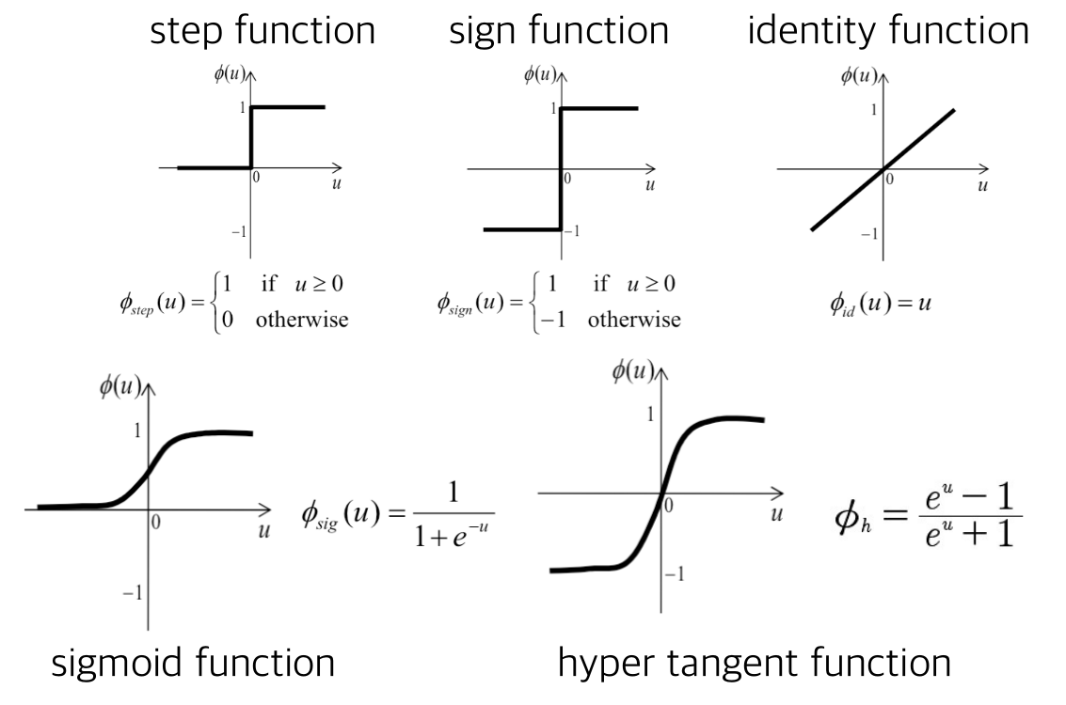
Activation Functions

Slide 7
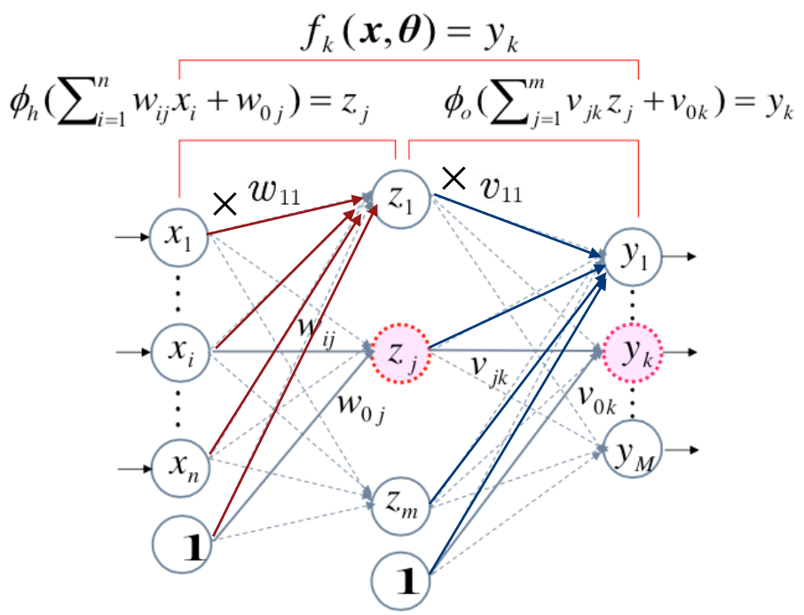
Feed forward

Slide 8
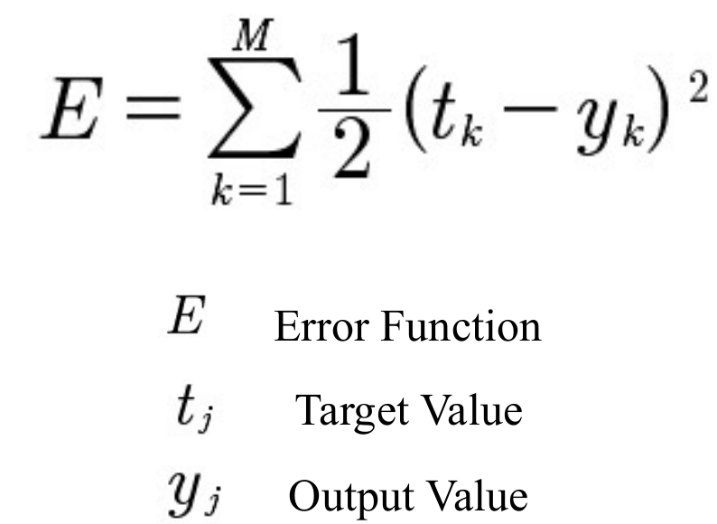
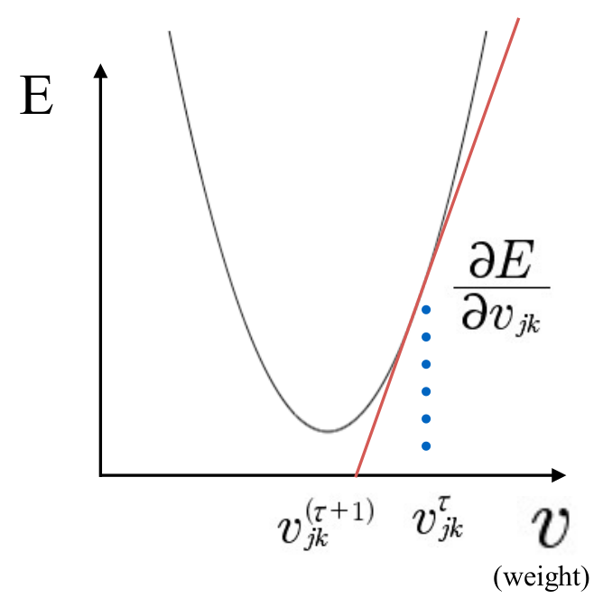
How to Learn Perceptron?
Cost Function (mean squared error – MSE)
Gradient Decent

Slide 9
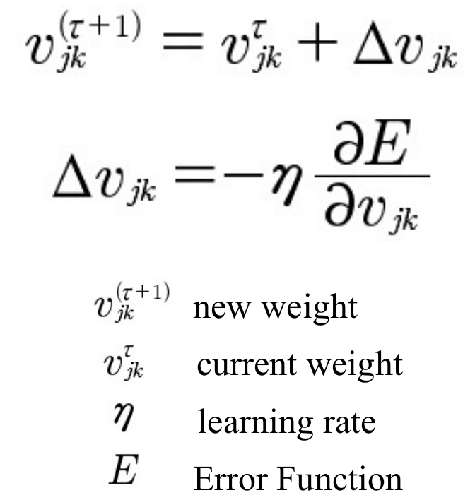
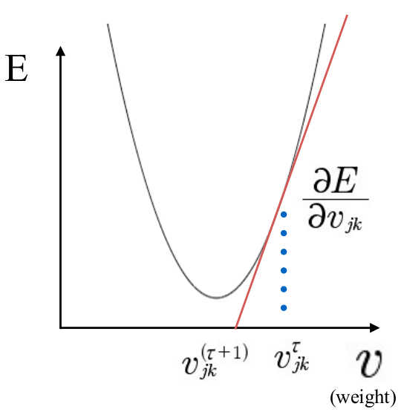
Gradient Decent

Slide 10
Propagation algorithm
Feed forward propagation
  Single perceptron
  Activation function
Back propagation

Slide 11
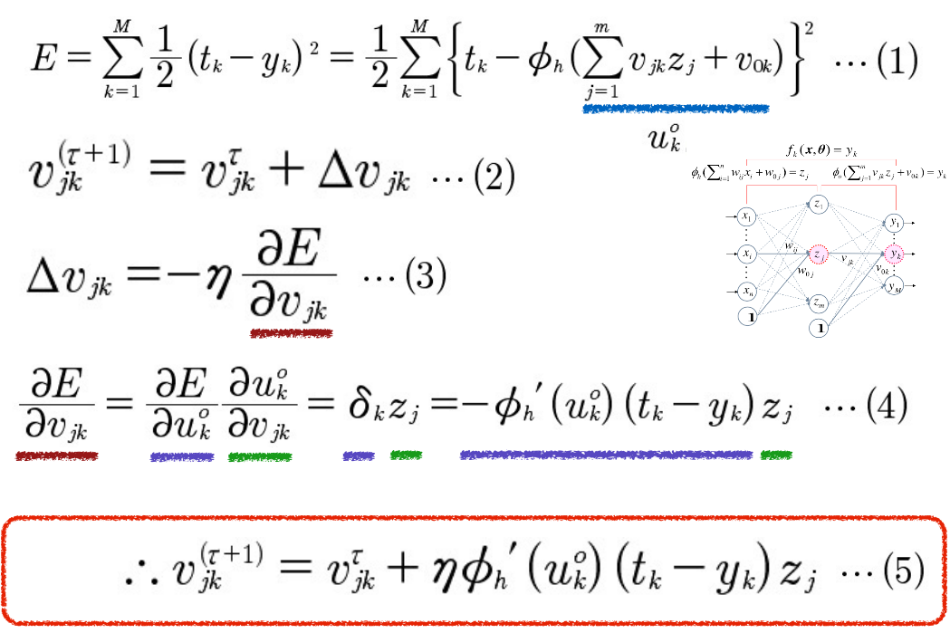
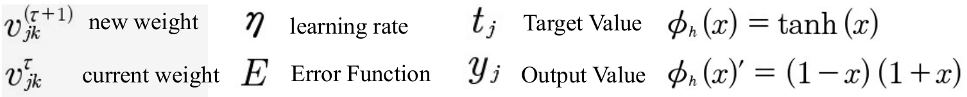
Back propagation (output layer)

Slide 12
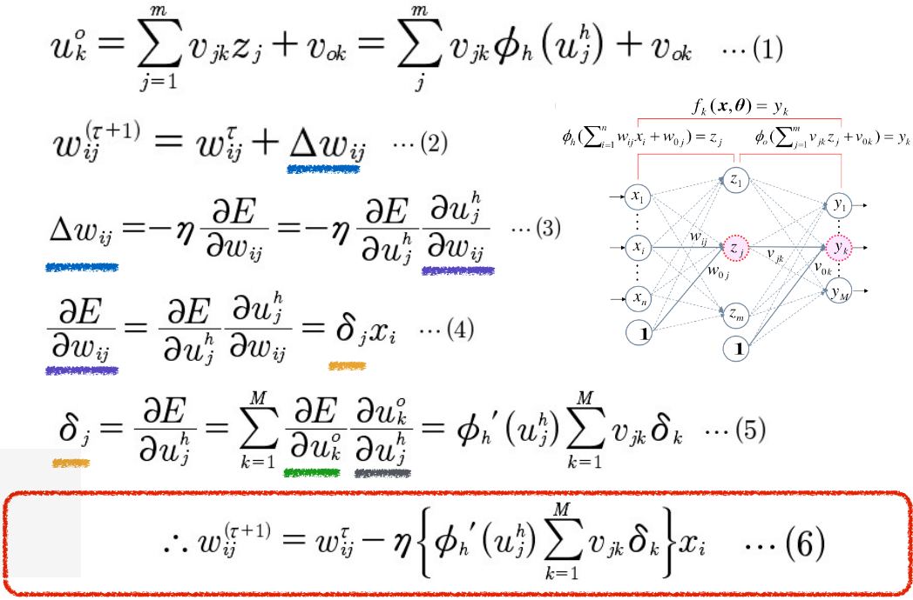
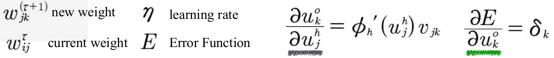
Back propagation (previous layers)

Slide 13
Hardware implementation papers
Using LUT for activation function, DSP
Using PE direction, includes: control, pattern, architecture block
Using math algorithm direction

Slide 14
Discussion
Design direction:
  area, energy, performance
  PE or folow math
  Memory?
Division jobs, global rules…
Available:
  SW: C++ src
  HW: Verilog from LSI contest
  ANN is the matrix multipliers
  ANN is the matrix multipliers (??)

Slide 15
Plan future

Slide 16
The end

Slide 17
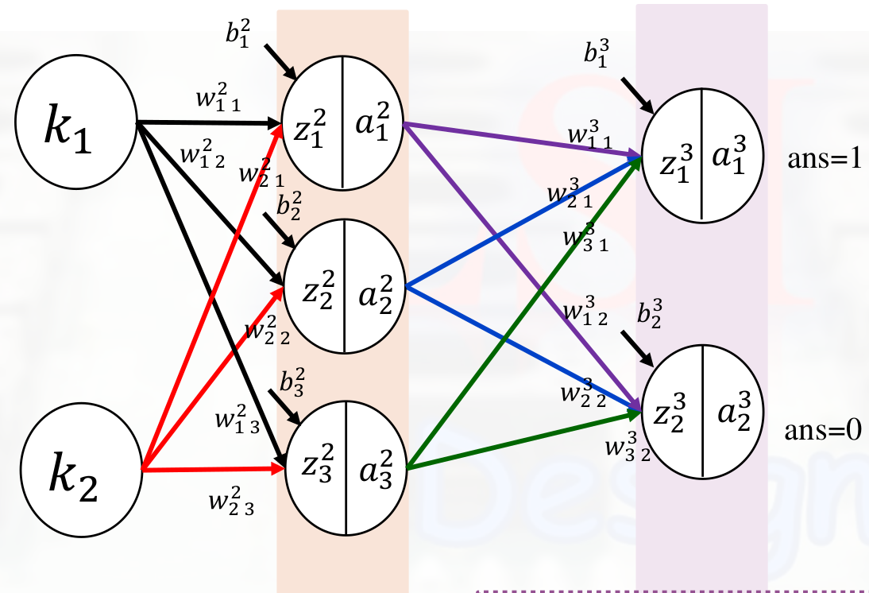
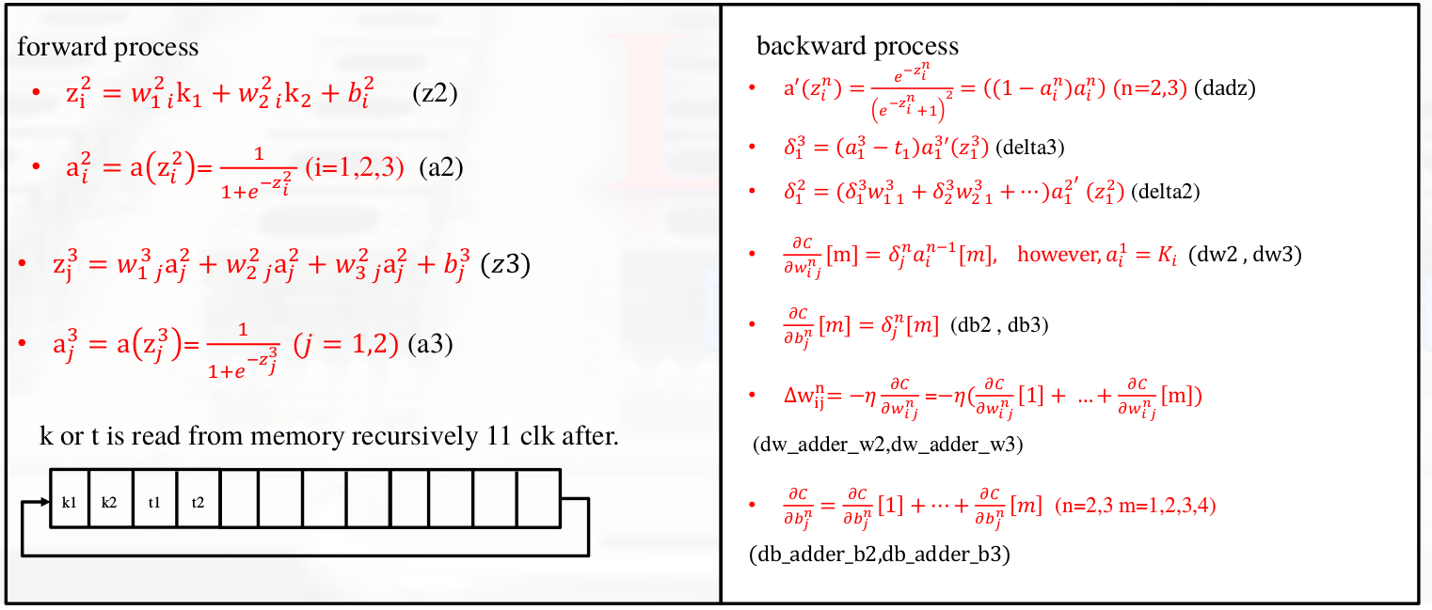
Example

Slide 18
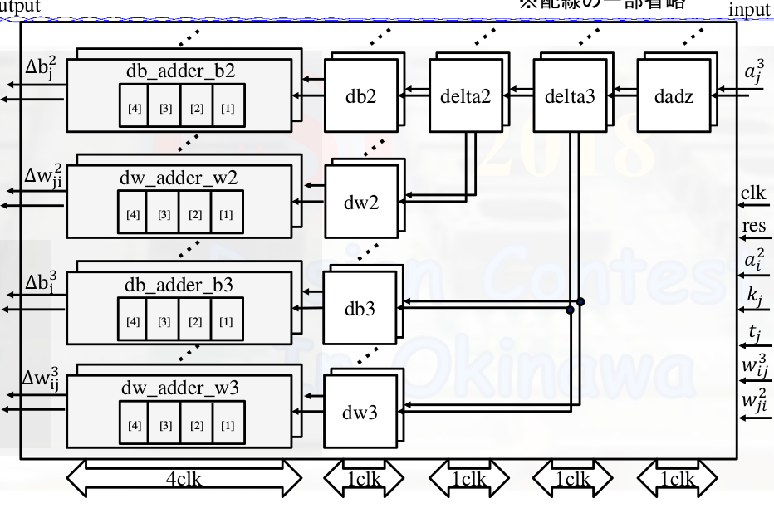
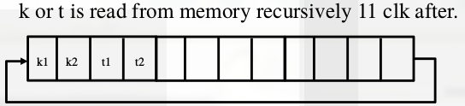
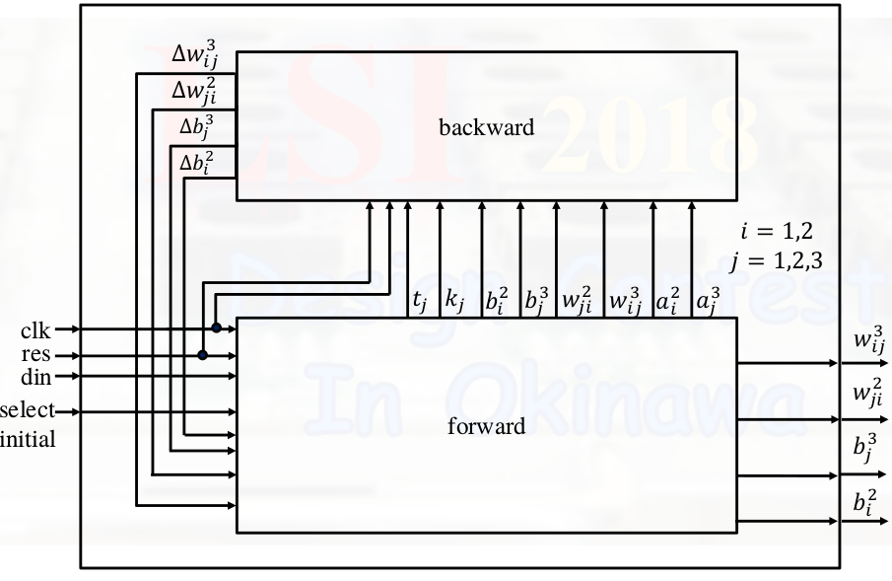
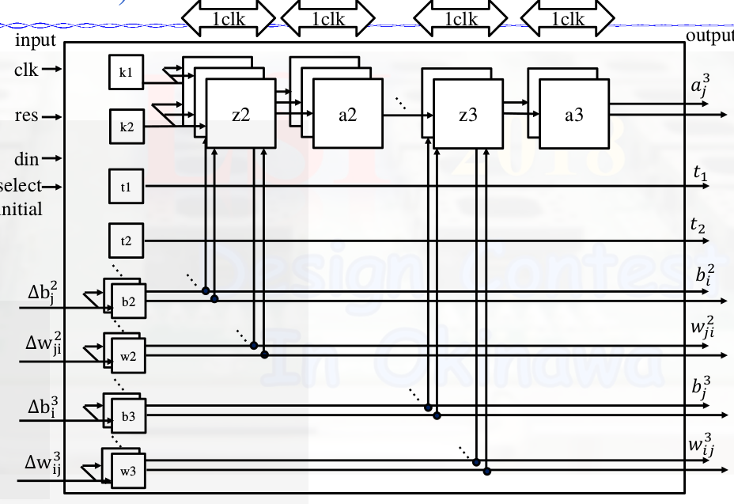
Hardware example

Slide 19
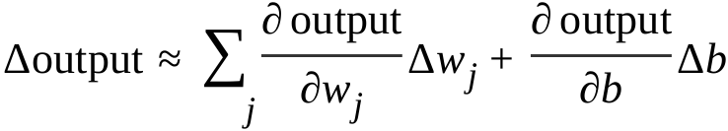
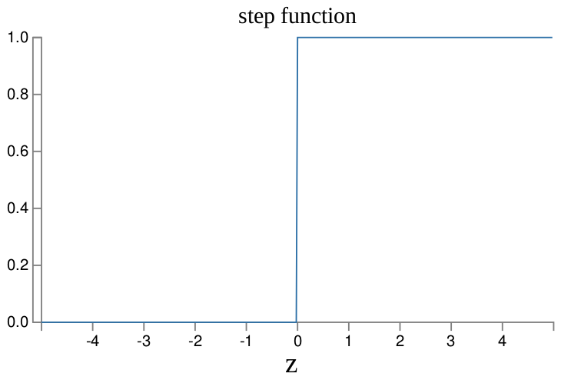
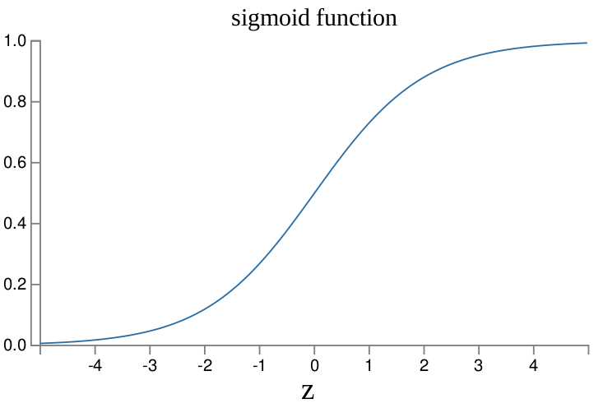
Why signmoid function?
Sigmoid function is easy to differentiate and easy to compute forward
Smoothness (Δoutput is a linear function of the changes Δw j and Δb in the weights and bias):

